Slide 1
Lesson 2: Discussion of Experimental Set-up

Slide 2
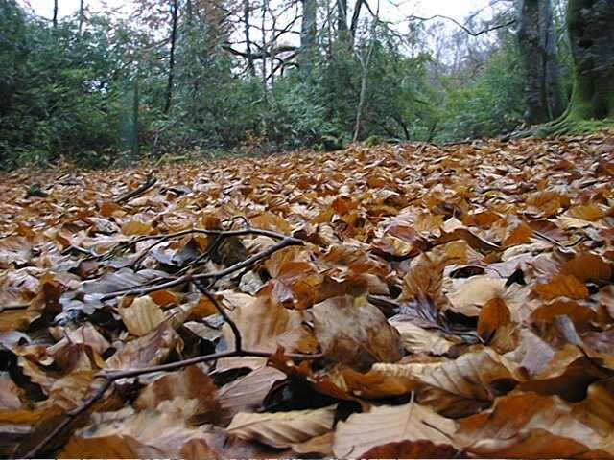
What comes from the riparian zone of the stream?

Slide 3
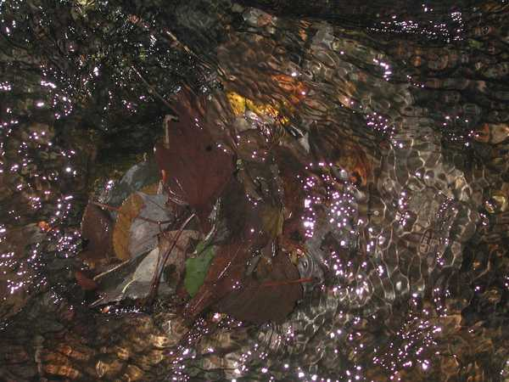
What could affect whether, and which, organisms colonize a leaf pack?
Natural leaf pack in a stream
Notes:
Hand out some leaf packs for students to observe

Slide 4
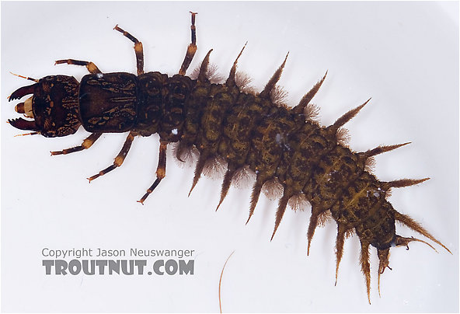
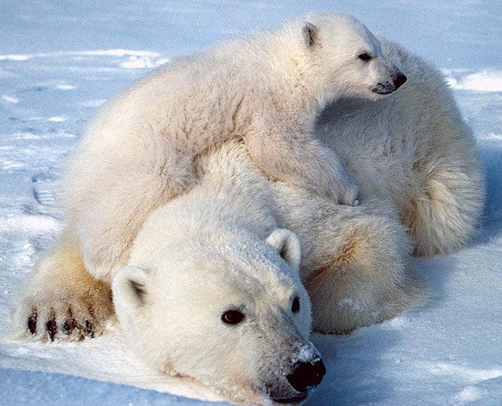
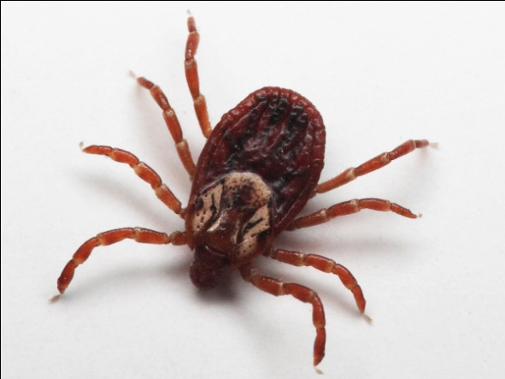
Decide whether each of these organisms could colonize a leaf pack – why would some of these organisms be more or less successful?

Slide 5
What determines whether an organism can live in an ecosystem?
Dispersal - can the organism get there?
Abiotic resources and conditions – can the organism survive the temperature, light etc?
Biotic resources and interactions - does it have food, what eats it, are there diseases?

Slide 6
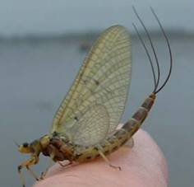
Let’s look at one organism that might live in our stream:
Mayfly larva (on left). Adult mayfly (right).

Slide 7
What would affect the survival of the mayfly?
Things that might affect dispersal of the mayfly | Abiotic factors that might be important to the mayfly | Biotic interactions that might be important to the mayfly

